Slide 1
Leading National Assessment Seminar 2021
Welcome

Slide 2
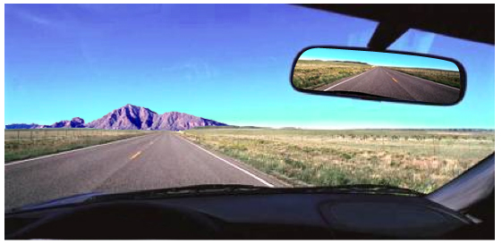
Whakatauki
Titiro whakamuri, kōkiri whakamua
Look back and reflect so you can see forward

Slide 3
Seminar programme
8:45am – 10:30am (9:30am – 11:15am) | Future assessment responding to change change management
10:30am – 11.00am (11:15am – 11:45am) | Morning Tea
11.00am – 12:30pm (11:45am – 1:15pm) | Opportunities offered through: the Review of Achievement Standards NCEA Online changes to resubmission and course endorsement
Qualify for the Future World | Kia noho takatu ki tō āmua ao

Slide 4
Our focus questions to lead assessment change
Where do you want to be in 5 years?
Where are you now?
How do you get there?

Slide 5


2020
The best year of my life!

Slide 6

What does the future look like?

Slide 7
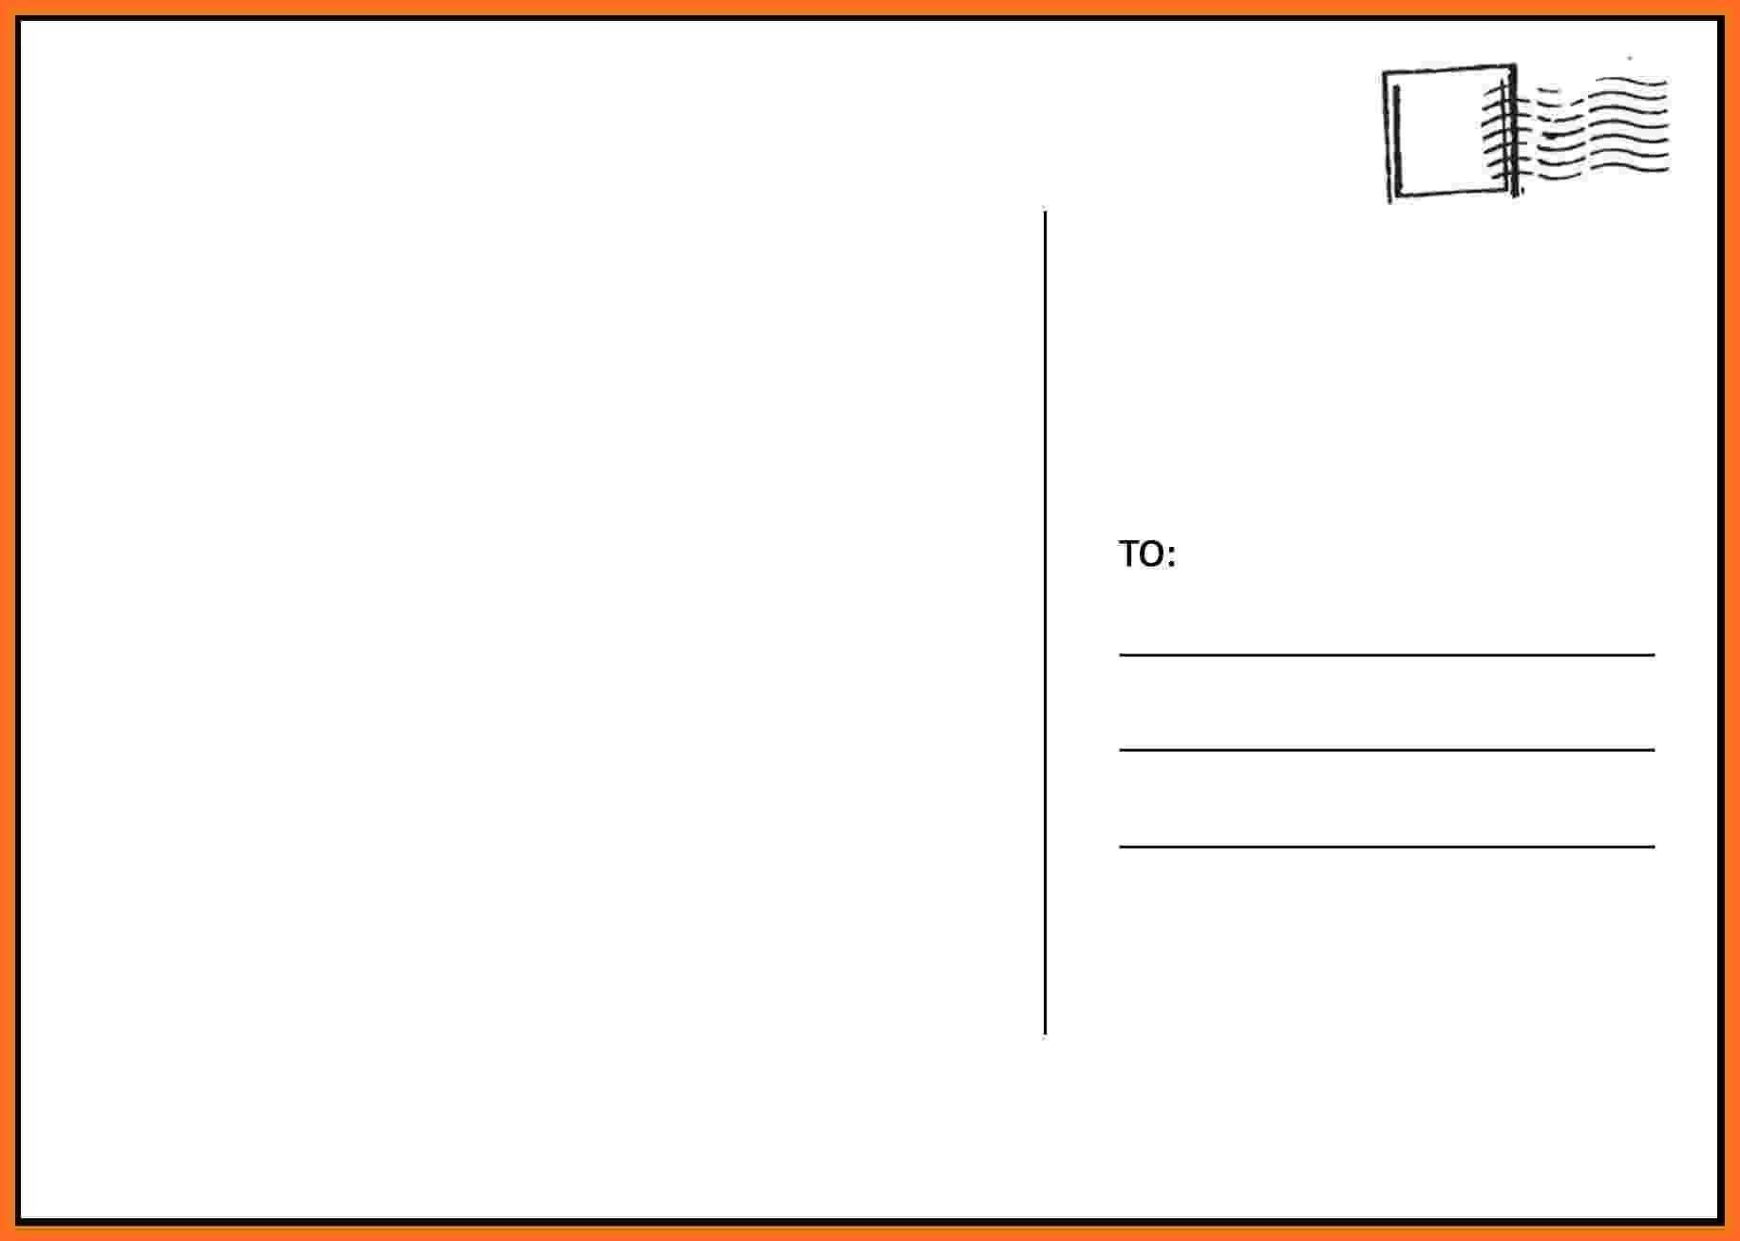

Postcard from the future
Looking back to look forward
What would be the same?
What would have changed?
What challenges would be overcome?
What opportunities will the future present?
Me in the past

Slide 8
Responding to Change
With any change, we know there will be a decline in productivity and an increase in resistance – Prosci founder, Jeff Hiatt
Everyone thinks of changing the world, but no one thinks of changing himself - Leo Tolstoy

Slide 9
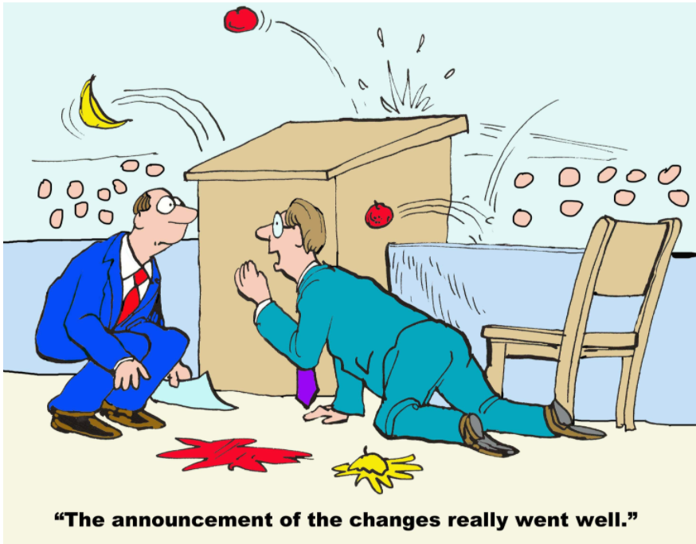
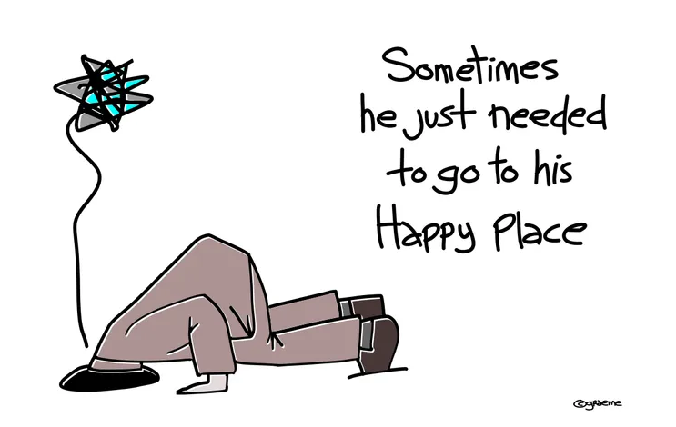
Your response

Slide 10
Changes: What Now?
Proactive: controlling a situation by making things happen or by preparing for possible future problems i.e. manage your response.
Reactive: making changes in response to other shifts i.e. let it happen to you.

Slide 11
Changes: Responding to Change
What is the nature of the change?
Why is change needed?
What is the risk of not changing?
Which parts should we not change?
What is school/kura leadership prepared to do?
Who do you need to engage with?

Slide 12
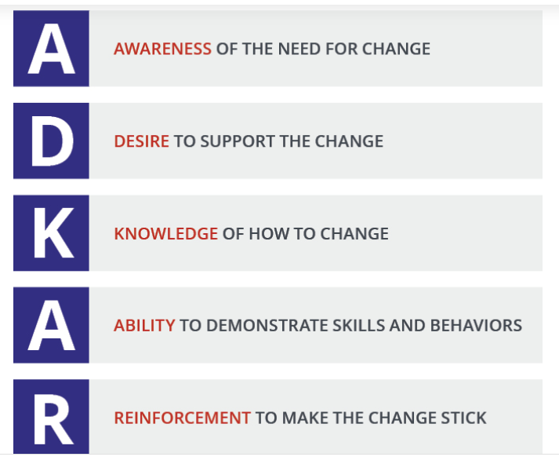
How does change happen?
5 Steps for Change

Slide 13
ADKAR and the states of change
CURRENT
TRANSITION
FUTURE
A
D
K
A
R

Slide 14
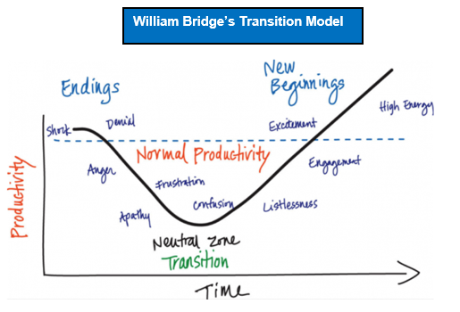
Transition state

Slide 15

Morning Tea

Slide 16
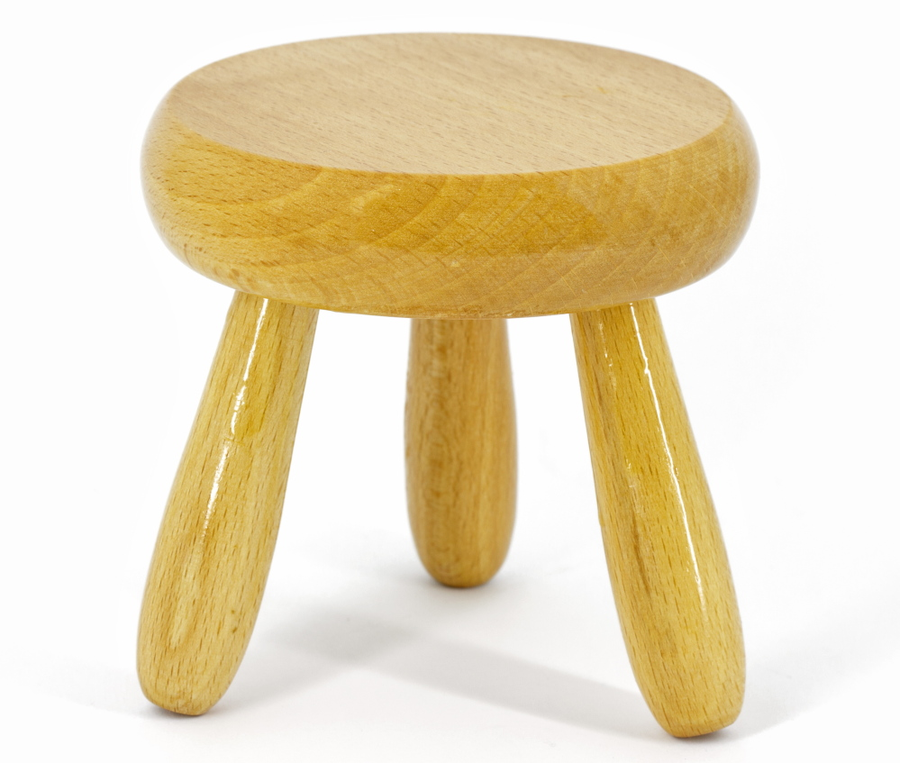
Foundations of student/ākonga achievement
Pathways Credible Equitable
Assessment Access

Slide 17
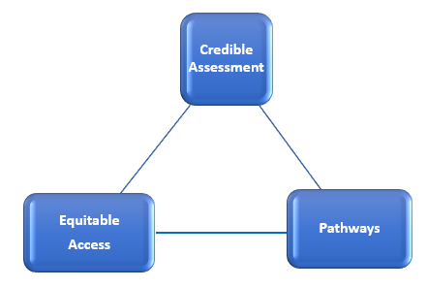
Unpacking the RAS

Slide 18

RAS opportunities
Externals?
Two exams?
Single event?
Portfolio?
Course or subject based?
Year-long or semester?
Literacy and numeracy?
Vocational Entrance?
NCEA?
University Entrance?

Slide 19
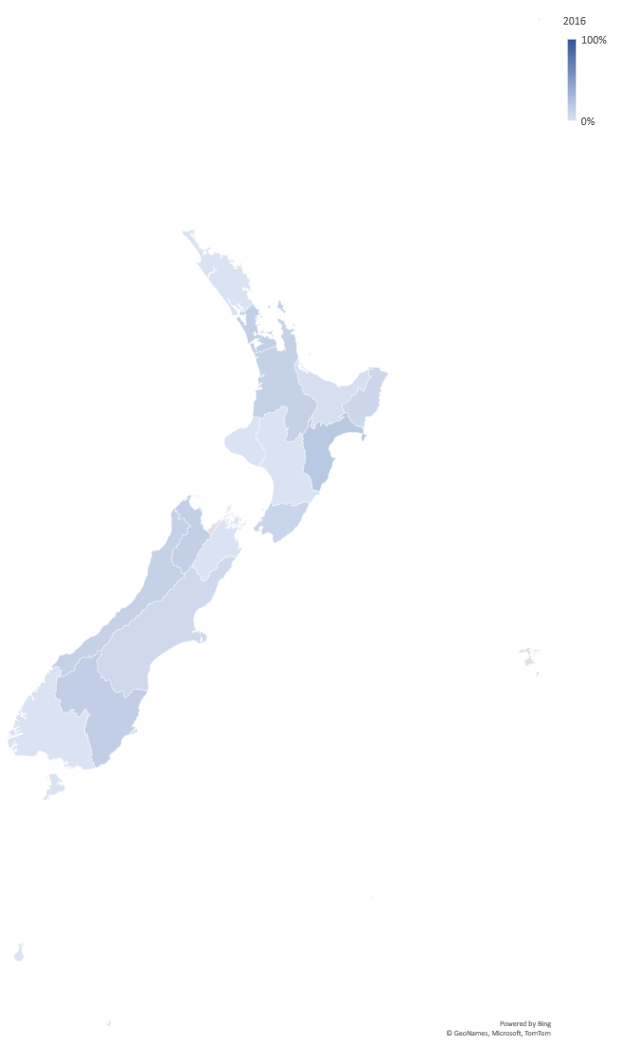

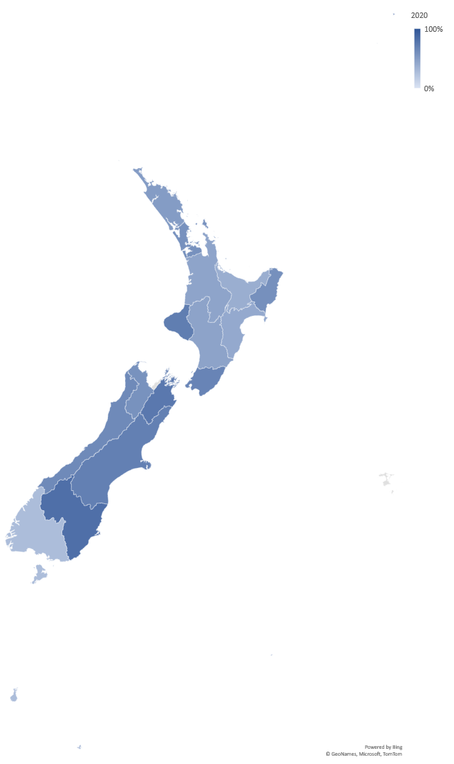

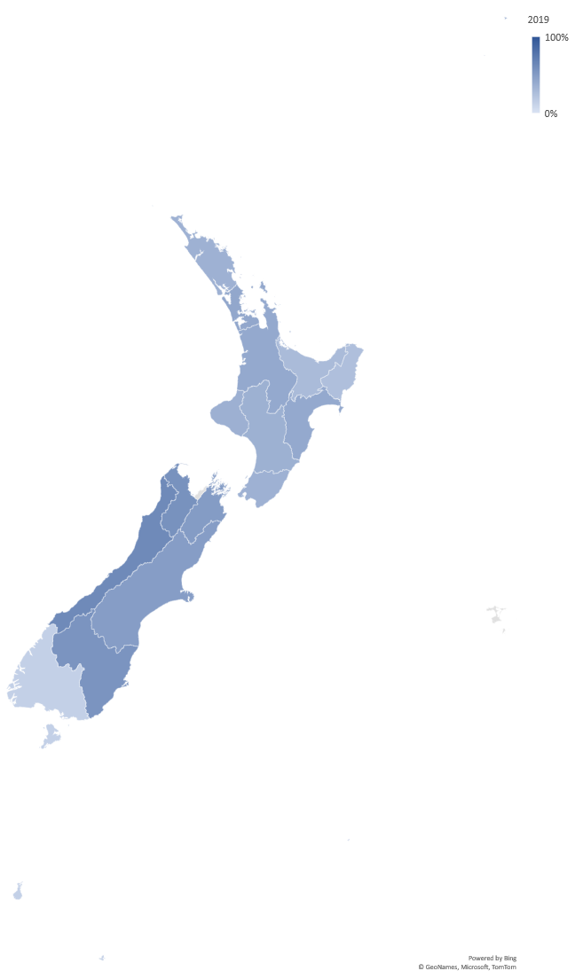
NCEA Online
Moving to the Future State
% of schools/kura by region that have participated in NCEA Online

Slide 20
Current State
2020
Practice Exams
96 schools/kura and more than 6,200 students/ākonga
External Exams
22,590 students/ākonga from 277 schools/kura sat at least one digital exam, offered in 21 subjects
increase: students/ākonga 55% and schools/kura 41% compared to 2019

Slide 21
Transition State
2021
Practice Exams
2021: extended availability: 2 August – 1 October
use as evidence for derived grades
Involvement will:
affirm school/kura ability to run end-of-year digital exams
help teachers/kaiako understand the digital platform
provide digital experience for students/ākonga

Slide 22
Moving to the Future State
By the end of 2022, NZQA wants all schools to have offered students/ākonga the opportunity to do at least one end-of-year digital exam
When should we move to “opt out” rather than “opt in” to digital exams?
Research, Innovation and Enhancements » NZQA

Slide 23
Courses, Programmes and Pathways
What is a course?
How important is course endorsement in deciding courses for your students/ākonga?
What changes would you make?
Refer to Circular Page 29 A2021/5 and Mythbuster 10 Pages 30 - 31

Slide 24
Credible Assessment
How will your approach to assessment change with the change to resubmission?
Refer to Circular Page 32 A2020/21 and Mythbuster #4 Page 33

Slide 25
Evaluation
Please complete the seminar evaluation
to record the support you need from us
and to help us improve our seminars.

Slide 26
Tēnā Koutou
Mā te wā

