Slide 1
Teachers new to NCEA standards-based assessment
2025 School Quality Assurance and Support

Slide 2

Nau mai haere mai!
After this course you will be able to
    Describe the requirements to achieve a NCEA qualification and UE award
    Tailor assessments to meet individual student needs
    Explain the different parts of a standard and why they are important
    Explain how to mark and quality assure NCEA assessment standards.

Slide 3
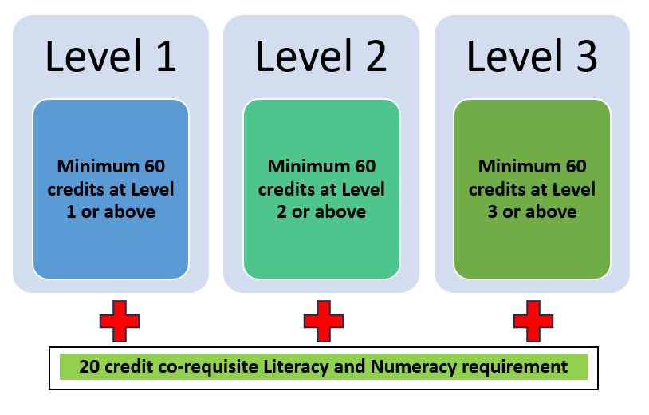
NCEA at a glance = 80 credit qualification

Slide 4
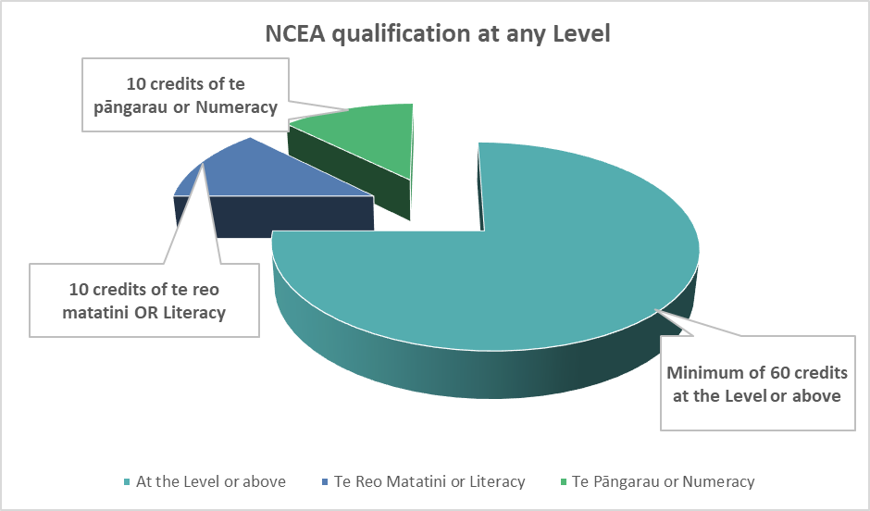
Levels 1, 2 and 3 NCEA requirements
NCEA Assessment standards include
      Achievement Standards – NZC / TMOA¹
      Unit Standards – work-related skills
  At each level, students must achieve at least 80 credits to gain an NCEA certificate, inclusive of the 20 credit NCEA Co-requisite.
  The NCEA Co-requisite is a required measure of competency in literacy and numeracy.
  1. Standards derived from NZ curriculum documents (check you are using current information - see Tāhūrangi Ministry of Education site)

Slide 5

The Co-requisite requirement – for Levels 1, 2, 3
Literacy credit options
Dedicated literacy unit standards 32403 and 32405, or
Te reo matatini 32413 and 32415
Approved assessment standards –achievement and unit standards available in a range of subjects from 2024-2027.
Numeracy credit options
Dedicated numeracy unit standard 32406, or
Te pāngarau 32412, or
Approved assessment standards –achievement and unit standards available in a range of subjects from 2024 - 2027.

Slide 6


NCEA requirements - quiz
Te Reo Māori standards can be used for Literacy in 2025 by any students
Students can get University Entrance with just Level 3 NCEA
Students need Literacy and Numeracy credits to get a qualification
Students must get at least 14 credits in each subject to get Level 1 NCEA
Year 10 students can complete standards for NCEA

Slide 7

Standards-based assessment for NCEA
Standards-based assessment for NCEA involves
  collecting evidence from student work
  determining whether the evidence meets the criteria of the standard.
Standards-based assessment for NCEA does not involve
  ranking students or comparing their work against each other’s
  a set number of students who can pass the standard or get a particular grade
  changing the standard in any way.
Every standard
  has a level that shows the complexity and skill it takes to achieve the standard.
  is worth credits; one credit represents about 10 hours of teaching, learning and assessment.
  may be used to assess any students who is ready.

Slide 8

Student-centred internal assessment
Consider an assessment task that involves students completing independent research and presenting their findings in your subject.
How could the task be adapted to suit students who:
      Live on a small island
      Have very messy handwriting
      Don’t have access to a computer at home
      Have just arrived at your school
Notes:
Go to pg 9 of the Handbook and write your answer.

Slide 9
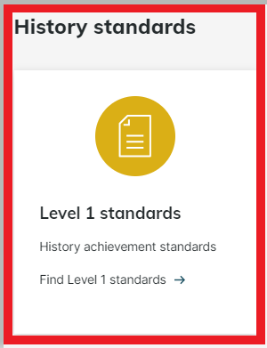
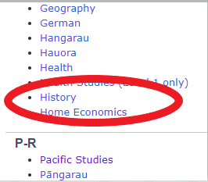

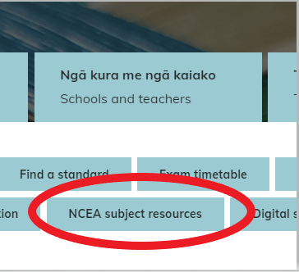
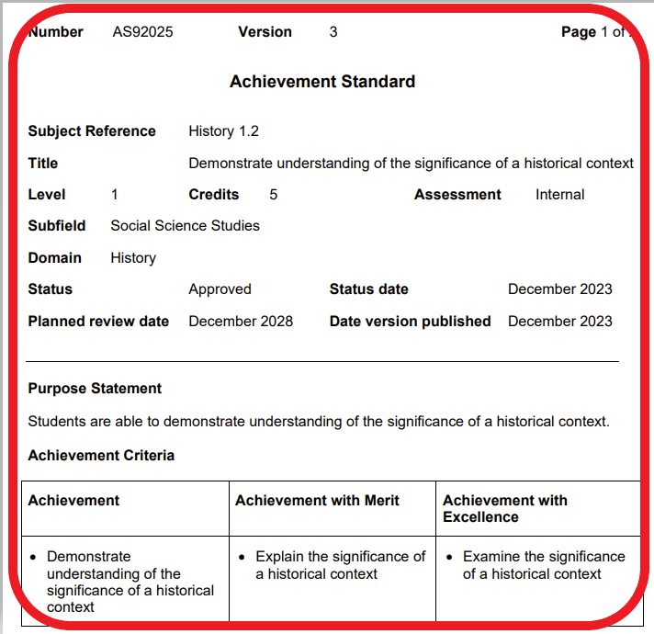
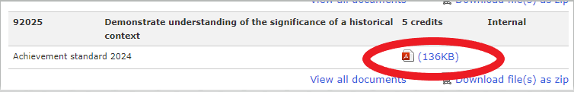
Find a standard in your subject

Slide 10
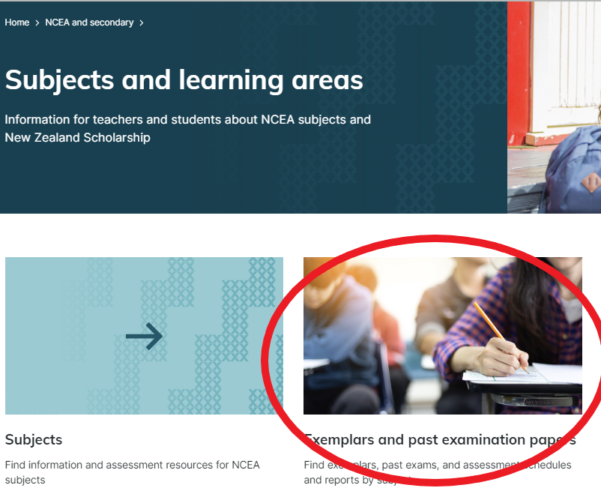
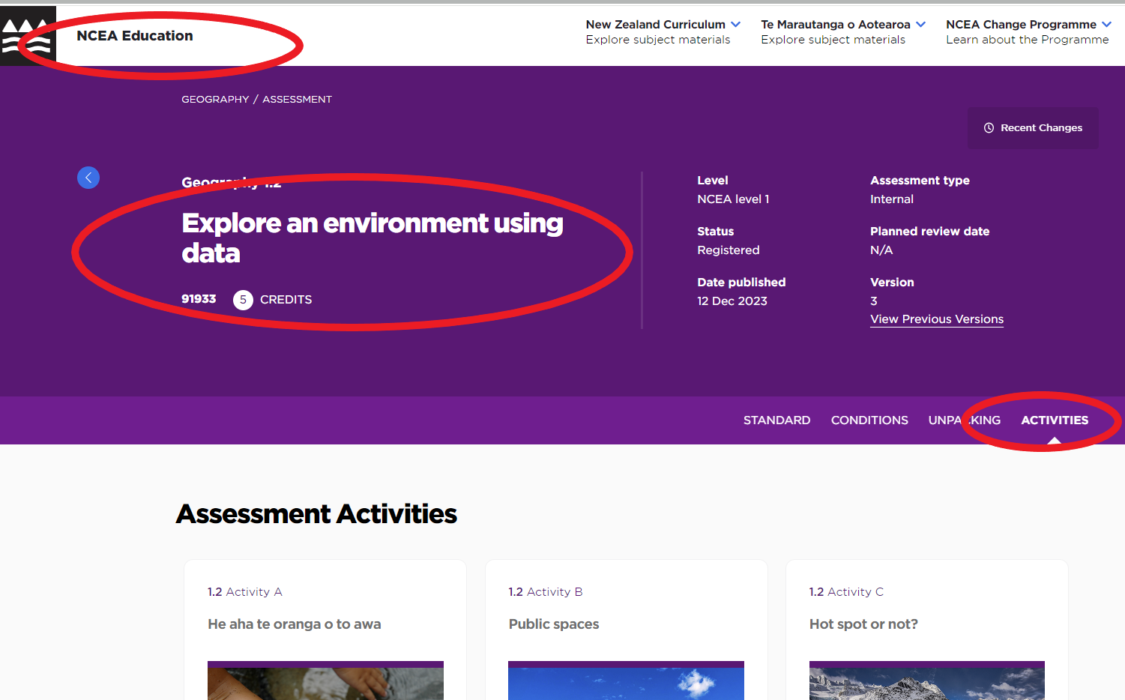
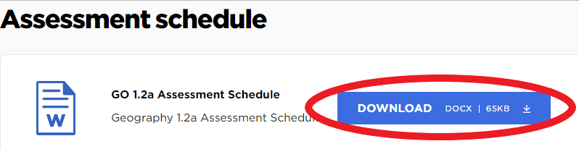
An Internal Achievement Standard
Identify the different parts of your standard.
Find an exemplar for your standard
Find a sample assessment task for your standard
Find the assessment schedule for the task.

Slide 11

Assessment and Quality Assurance for NCEA
1. Support to help you with assessment
2. Internal moderation
  managed by the school
  critiquing the task
  verifying the grades
  every standard, every year, every teacher
3. External moderation
  submitted to NZQA
  moderated by NZQA experts
  report on consistency with the standard
  must be followed up by the school

Slide 12
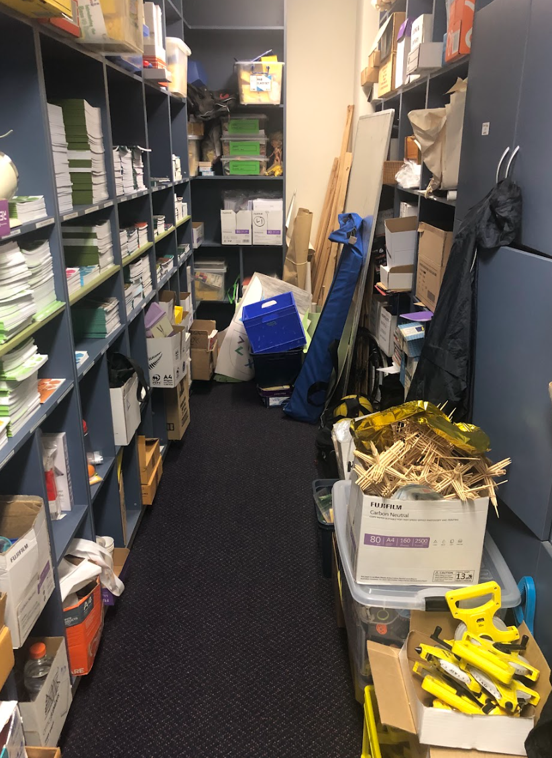
Good luck – you’ll be fine!
Ask for help. Don’t reinvent the wheel
Ask the experts – they like it
Read the available resources
Know the standard, then let go of it, and focus on the teaching and learning
Use moderation to improve your practice
Follow your school’s policies and processes

Slide 13
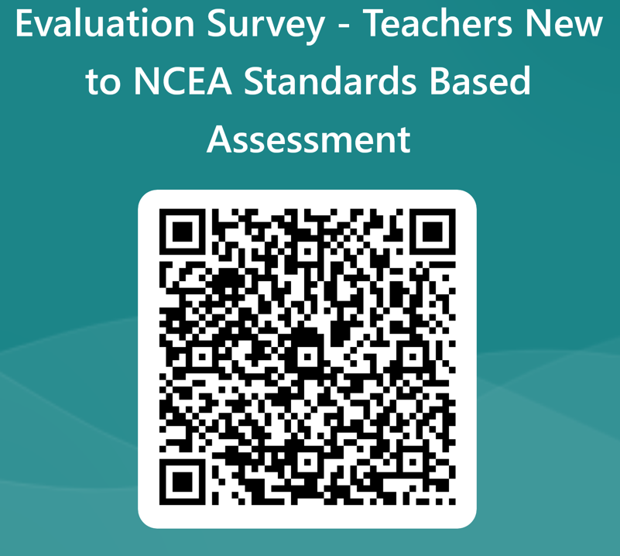

Slide 14

Kia ora
Thank you
www.nzqa.govt.nz

